Slide 1


Slide 3


Slide 4
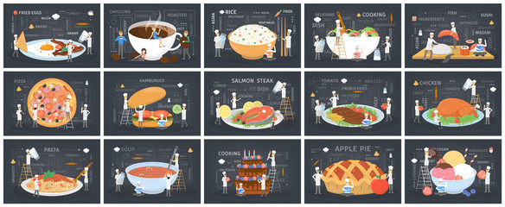

Slide 5

FOOD MENU
Sizzle Dazzle Brownie | Rs 219
Butterscotch Mousse | Rs 85
Royal Opera Pastry | Rs 176
Crackeling Brownie | Rs 167

Slide 6

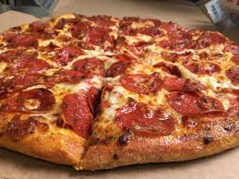
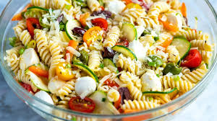
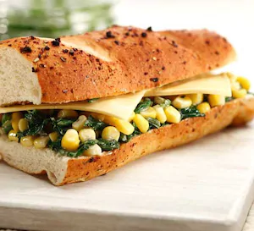

FOOD MENU
HEARTY SANDWICHES
PIZZAS
Angara Tandoori Paneer | Rs 210
Cheesy Corn ‘N’ Spinach | Rs 185
Wood Smoked Chicken | Rs 248
Angara Tandoori Paneer | Rs 233
Margarita | Rs 210
Veg Delight | Rs 185
Chicken Tikka | Rs 248
Paneer Makhni | Rs 233
SOUPS
Tomato and Basil | Rs 220
Cream and Mushrooms | Rs 220
Lemon Coriander | Rs 270
Chicken Manchow | Rs 300
SALADS
DIVINE DESSERTS
Fatush | Rs 210
Cheese Pineapple | Rs 255
Greek | Rs 278
Tossed Capsicum and Cheese | Rs 253
Sizzle Dazzle Brownie | Rs 219
Butterscotch Mousse | Rs 85
Royal Opera Pastry | Rs 176
Crackeling Brownie | Rs 167

Slide 7
Angara Tandoori Paneer Rs 210
Cheesy Corn ‘N’ Spinach Rs 185
Wood Smoked Chicken Rs 248
Angara Tandoori Paneer Rs 233

